Slide 1
Introduction to Web Page Design

Slide 2
Web Design Information
Background on the web
Terminology
Web design principles
Files on the web
Some theoretical considerations
Further advice

Slide 3
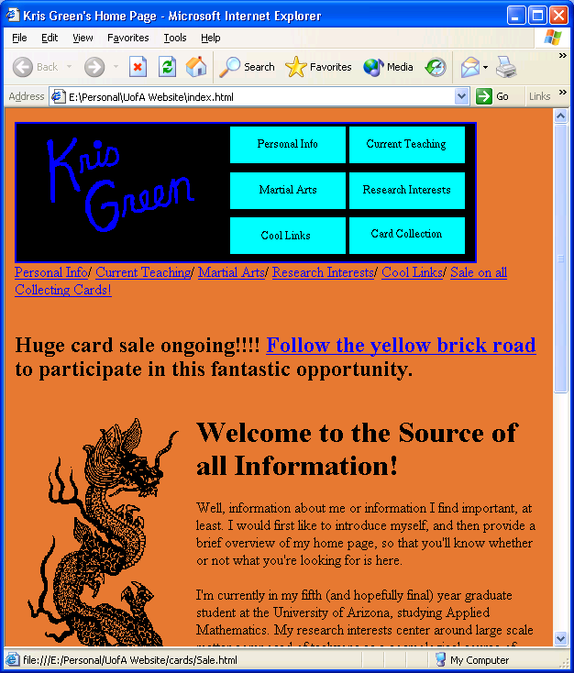
In the beginning…
The WWW used straight HTML (Hyper Text Markup Language).
And it was good…
A little plain, an absolute pain, and completely unformatted, but it was good.
<html>
<title> Kris Green's Home Page</title>
<body bgcolor=#e47833>
<img src="gifs/dragon.gif" align=left>
<h1> Welcome to the Source of all Information! </h1>
Well, information about me or information I find important, at least. I would first like to introduce myself, and then provide a brief overview of my home page, so that you'll know whether or not what you're looking for is here.<br> <br> <p>I'm currently in my fifth (and hopefully final) year graduate student at the University of Arizona, studying Applied Mathematics. My research interests center around large scale matter composed of tachyons as a cosmological source of structure. I also teach here in the math department, and if you're interested in some materials related to the course I'm currently teaching, follow the link above marked "Current Teaching".<p>Second, I enjoy martial arts. While I was an undergraduate at the University of Tennessee, I studied Isshinryu Karate under Bill Rader, a fourth generation student via Mr. Wheeler. I achieved the rank of First Kyu (or brown belt).
</body>
<hr>
<address>Kris Green/<a href="http://www.math.arizona.edu"> Department of Mathematics</a> /<a href="http://www.arizona.edu">The University of Arizona</a> /last revised November 7, 1998</address>
</html>

Slide 4



And…
You couldn’t just “post the web page”; you had to use FTP (File Transfer Protocol) to get it into place
You had to type all the code into a text editor, then load it into the browser to view the results, then change the code, then reload, then…
Plus, all the browsers did stuff differently

Slide 5
Later…
We got new features:
  Tables
  Frames
  Image maps
  CGI Scripting
These gave users a way to control formatting, make navigation easier, and provide some interactivity (like forms...)

Slide 6



Even later…
We got WYSIWYG Interfaces (Frontpage and other packages)*
We got Java, Javascript, XML, DHTML, CSS, Flash, Swish, Pop-up adds, P2P downloads…
* Now called GUI (Graphical User Interfaces).

Slide 7
Introduction to Terminology
Pages --
single HTML or HTM file
(Hyper Text Markup)
all information related to a single theme
usually small (in physical file size)
requires planning for layout
Sites --
consist of multiple pages
integrates several different themes
can be immense
requires more careful planning for design and navigation

Slide 8
What’s in a name (URLs)
URL = Uniform Resource Locator
Contains three parts:
  Protocol (http, ftp, etc.)
  Server name
  File name, including path
http://keep2.sjfc.edu/faculty/green/default.htm
Protocol for reading
Server name – extension tells type of server
File name and path*

Slide 9
The Basics of Web Design
Principles of graphic design for the web
Navigation concepts for the web
Organization of text on the web
Links from one page to another
Content and information
Editing and maintaining
Site design plans (graphical presentation)

Slide 10
Principles of Graphical Design
Keep the file size for the graphics small on the main page (use thumbnails with links to larger pictures, include file size information with link.)*
Use colors from the “standard color palette” to reduce file sizes and increase flexibility.
Keep backgrounds simple and not “busy”.
Keep the viewable size of the page in mind so you can avoid scrolling as much as possible.
* This is less important now with the large bandwidth Internet connections (RR and DSL).

Slide 11
Site Navigation Principles
Use a simple, consistent navigation interface.
Organize the pages so that there is less need for many confusing navigation buttons.
Remember, It’s the World Wide Web, NOT the World Wide Bowl of Spaghetti.
Carefully plan the site organization FIRST. Site design should be based on function and content.
Remember, “Three Clicks to Information”.

Slide 12
Text Organization Principles
Do not rely on spacing, tabs, or line breaks.
Use tables (with border=0) to space the information on the page.
Use horizontal lines to separate content, not for visual organization.
Use headings (H1 through H6) rather than fonts and font sizes to organize information.
Maintain a good, consistent visual hierarchy.
Lists are good for organization.

Slide 13
Links
Provide the user with information about the link (title of site, file size and format, etc.) rather than just a URL.
Don’t change the link colors, the followed link colors, or the basic text colors, if possible. People have learned to interpret the standard colors.
Use a simple, consistent navigation throughout the site.

Slide 14
Information (content)
Include author information and contact information to the author and site manager.
Focus the content of each page.
Provide a list of links to other web sites that support or “fill out” your material.
Vertical stratification of information is important to maintain consistency.
Be concise and factual.

Slide 15
Editing and Maintaining
By all means, spell check!
Frequently check active vs. dead links.
Show, on the page, the date of the last modifications to the site/page.
If you have to “take the site down” temporarily, provide an “under construction page” for the user with an estimated date of return.
Plan a naming convention for files FIRST so that updating and maintaining is less of a hassle.

Slide 16
Site Design Templates
Home
Page
A1
B1
C1
D1
A2
B2
C2
D2
A3
B3
C3
D3
Basic Grid Format
Hierarchical Format

Slide 17
More Templates
Sequential
Web Layout

Slide 18
Summary of Templates
Complex
Educated
Audiences
Simple
Basic content,
Training sites
Linear narrative
Predictable structure
Nonlinear, hyperlinked
Flexible, may be confusing

Slide 19
Files on the Web
HTML files = text document plus code
Browser interprets code
Code contained in tags (<h1> Stuff </h1>)
Each image, sound, video, etc. is a separate file – all must be placed in location for access to outside world. However, images can be re-used.

Slide 20
File Types on the Web
IMAGES
MOVIES
SOUND
FLASH MOVIE
STYLE SHEETS
DATA
TEXT DOCUMENTS
Other files
.gif, .jpg
others exist, but are not supported*
.rm, .avi, .mpeg, .mov
.wav, .mp3
.fla → .swf
.css
.xml
.doc, .pdf
.xls, .ppt, etc.
* Applies to most clip art (.wmf or anything).

Slide 21
More about files
Everything on your site must be in a publicly accessible folder – usually called public_html
Folders and file organization are critical
Paths to files are important
  Tree structure on the file server
  Relative or absolute paths

Slide 22
Theoretical Considerations
(Un)Intended consequences (see handout)
Scenarios for online classrooms (taken from a presentation by Gerald Boerner at the Syllabus Conference, 2002)
Effective web page elements for classroom support (taken from a presentation by G. Boerner at the Syllabus Conference, 2002)

Slide 23
Scenarios
Low-Tech traditional classroom
Technology-supported classroom
Web-aware hybrid classroom
Web-supported classroom
Web-based online classroom
All material in this section is copyright Gerald Boerner (2000) and is used without express written permission.

Slide 24
Effective Web Page Elements

Slide 25
Further Advice
Look to web sites that catch your attention for more hints.
Check out Dave Siegel’s book Creating Killer Web Sites and his web site at www.killersites.com/core.html
Try Web Style Guide by P. Lynch and S. Horton (available at SJFC Library).

